Slide 1
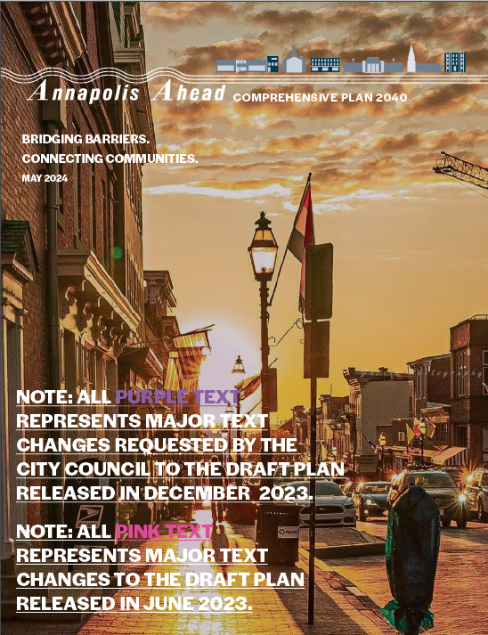
Draft Comp Plan Presentation
ECA Membership Meeting
18 June 2024

Slide 2
Presentation Coverage
Annapolis Ahead Comprehensive Plan 2040
Now 474 pages long
Accompanied by a 145-page Action Plan
And over 400 pages of Appendixes
Way too much to cover in this meeting
Means skipping over much good material

Slide 3
Draft Comprehensive Plan
Annapolis Ahead Comprehensive Plan 2040 is a land use document required by the state
Must be updated every 10 years, or so
Current Draft Plan has evolved over several years with much input, recently from the City Council

Slide 4
Significant Plan Contributions from Ward 8 Residents include:
The Need for an Action Plan
Public Water Access Recommendations
Bike and Pedestrian Connectivity Recommendations
Environmental Sustainability and Resilience Recommendations
Revitalization of Public Housing Recommendations
Small Business Development Recommendations (particularly maritime-related)

Slide 5
Presentation Focus
Plan Growth, Land Use & Housing Goals
Ward 8 Plan and 12 Redevelopment Areas
Adequate Public Facilities Planning
Next Steps for Adoption of the Plan
After Adoption Actions
Comments and Questions

Slide 6
Growth Patterns and Forecasts
Growth Composition – The City Has Mix of Housing Types
Traditional – market rate
Affordable – HACA and vouchers
Workforce – Income 50-100% of area median income (rental) and 60-120% of area median income (homeownership)
Note: No plan for incentives or subsidies
(see handouts 1& 2, Figures 3-3 to 6)

Slide 7
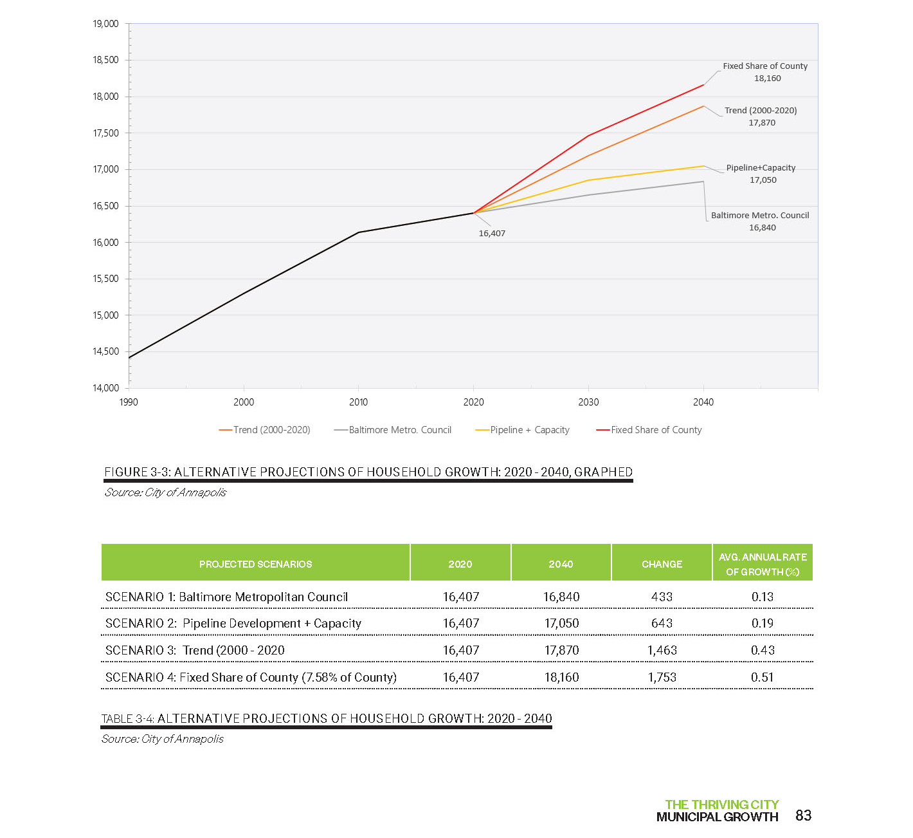
Notes:
TABLE 3-5: HOUSEHOLD PROJECTION AS A SHARE OF ANNE ARUNDEL COUNTY POPULATION
(See handout page 1.)

Slide 8
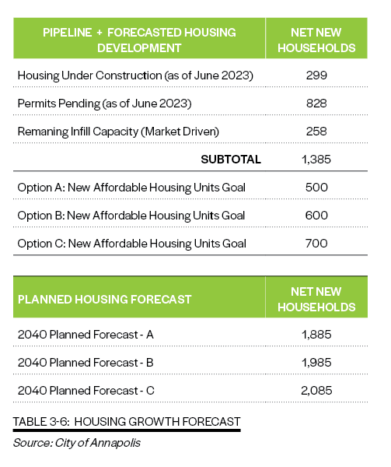
Notes:
TABLE 3-6: HOUSING GROWTH FORECAST

Slide 9
Future Land Use & Growth Areas
Future Land Use (Figure 4-5, Handout #3)
Mix of Housing Types
New areas of mixed-use retail and housing
Traditional , single-family largely remain
Growth Areas on City borders (Figure 3-14, Handout #3)
Annexations
Areas now or could be served by City sewer

Slide 10
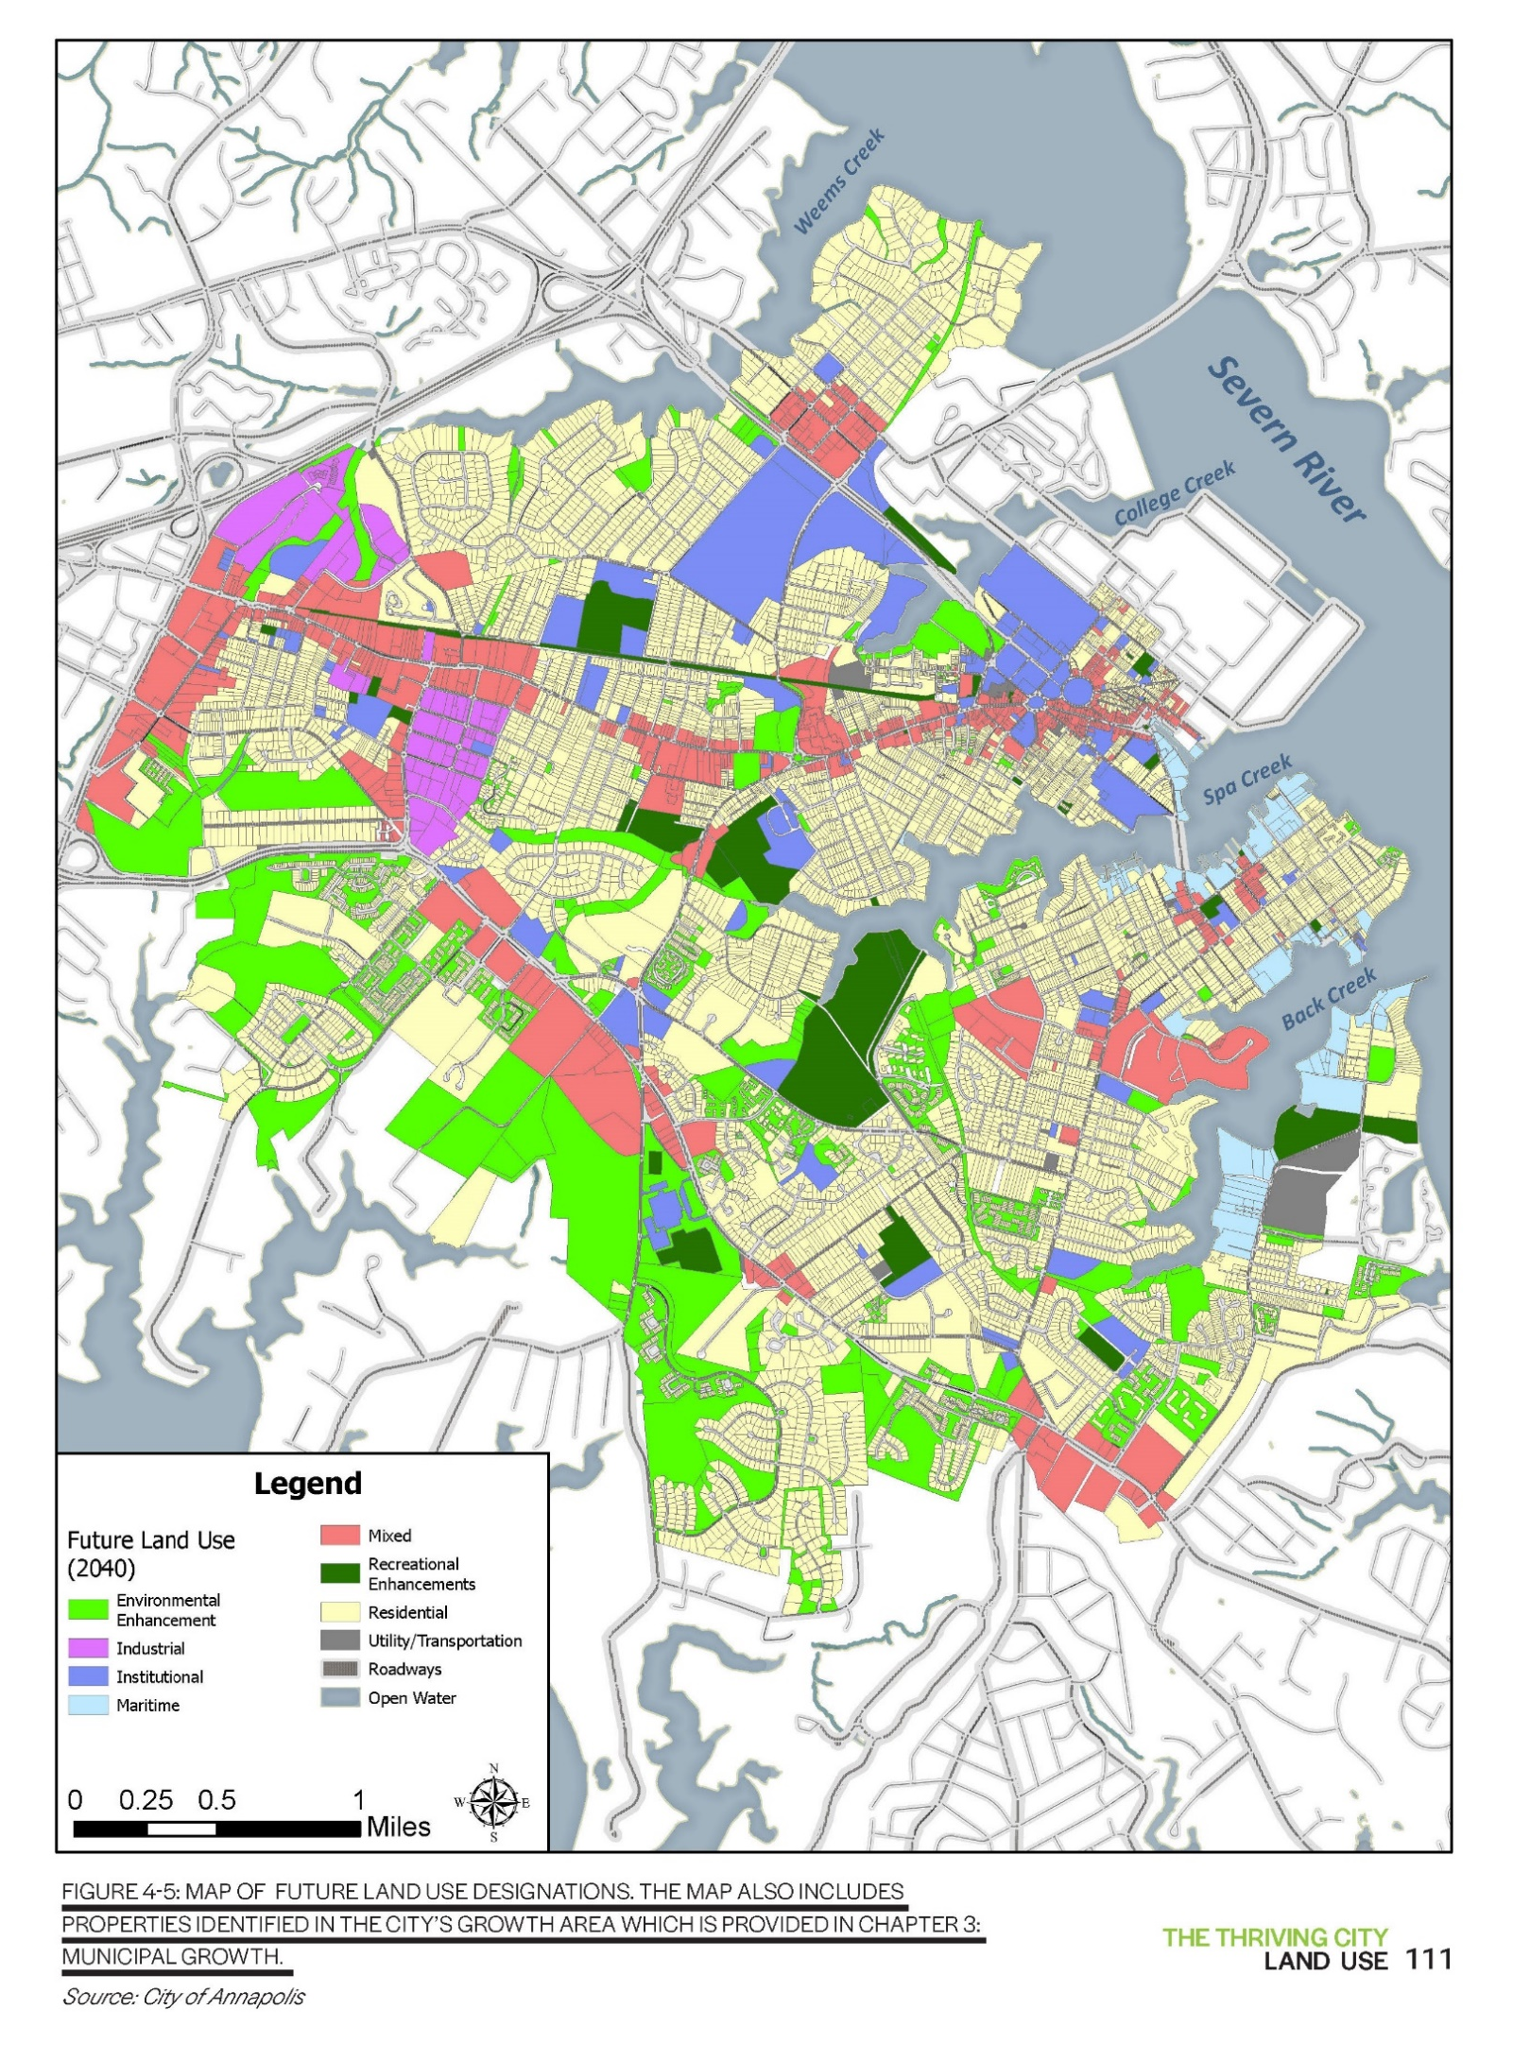
FUTURE LAND USE
Notes:
FIGURE 4-5: MAP OF FUTURE LAND USE DESIGNATIONS.
THE MAP ALSO INCLUDES PROPERTIES IDENTIFIED IN THE CITY’S GROWTH AREA WHICH IS PROVIDED IN CHAPTER 3: MUNICIPAL GROWTH.

Slide 11
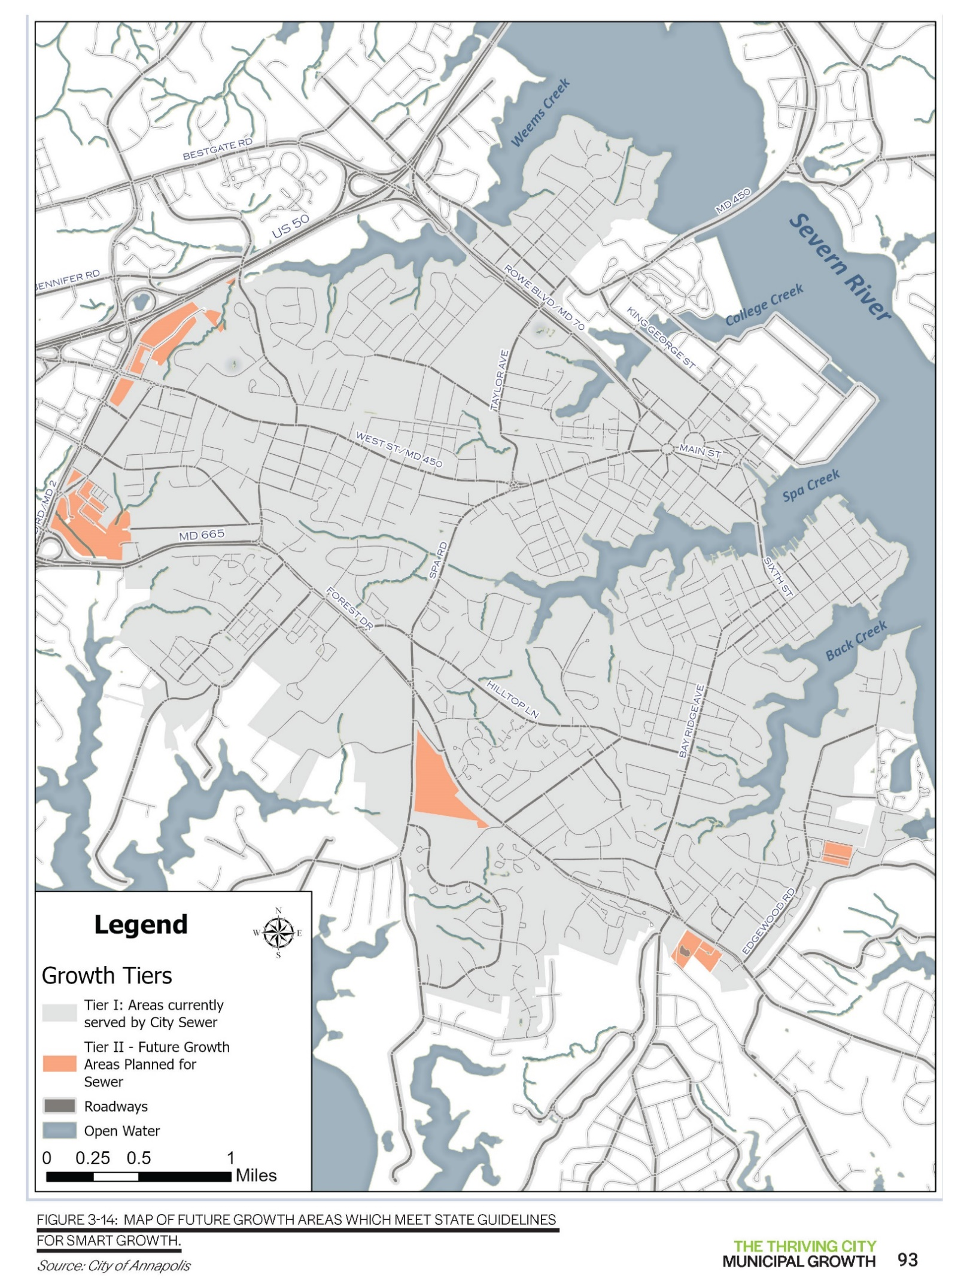
GROWTH AREA

Slide 12
Housing Goals
New Density To Be Achieved by More Mixed-use development (Figure 4-13, Handouts 4 & 5)
A development type in which various uses, such as office, retail, and residential, are combined in a single building or on a single
This development will need Zoning Code changes to be submitted to the Council after Plan adoption

Slide 13
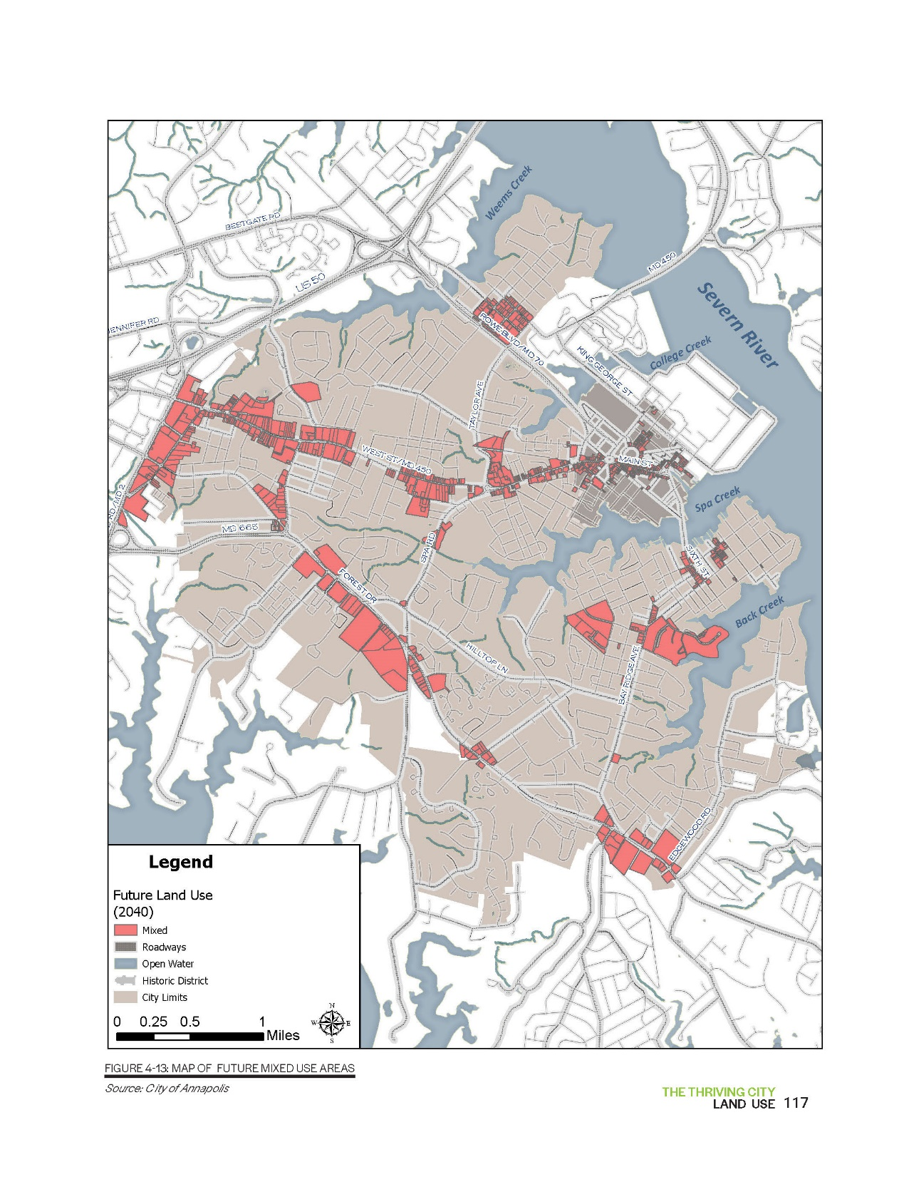
FUTURE LAND USE - MIXED USE
Notes:
FIGURE 4-13: MAP OF FUTURE MIXED USE AREAS

Slide 14
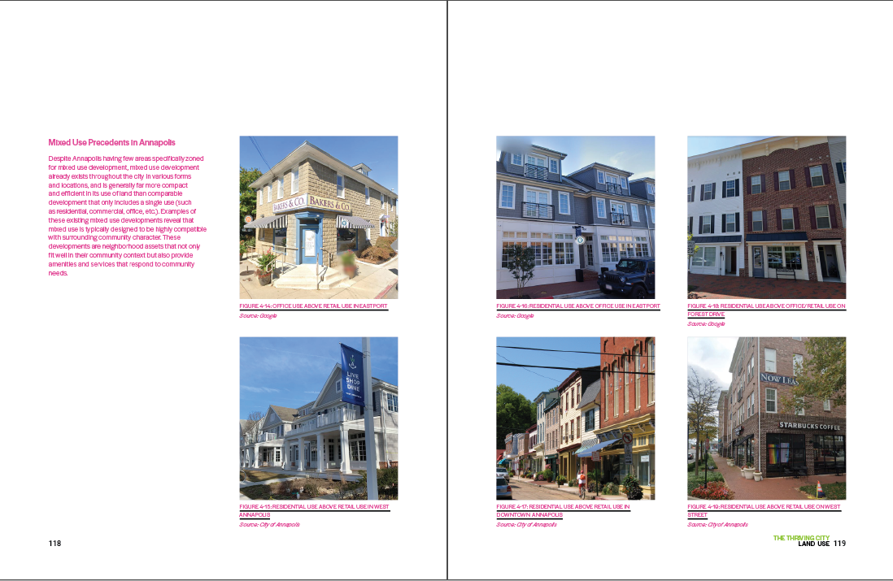
MIXED USE PRECEDENTS IN ANNAPOLIS TODAY

Slide 15
Areas Planned For Growth
Growth planned for 12 redevelopment areas (figure 4-22, handout #6)
Creates denser mixed commercial and residential (figure 4-23 & 4-26, Handouts 7 & 8)
Housing – Missing Middle (Figures 5-12, 13, 17)
Two different uses of term missing middle, massing and income

Slide 16
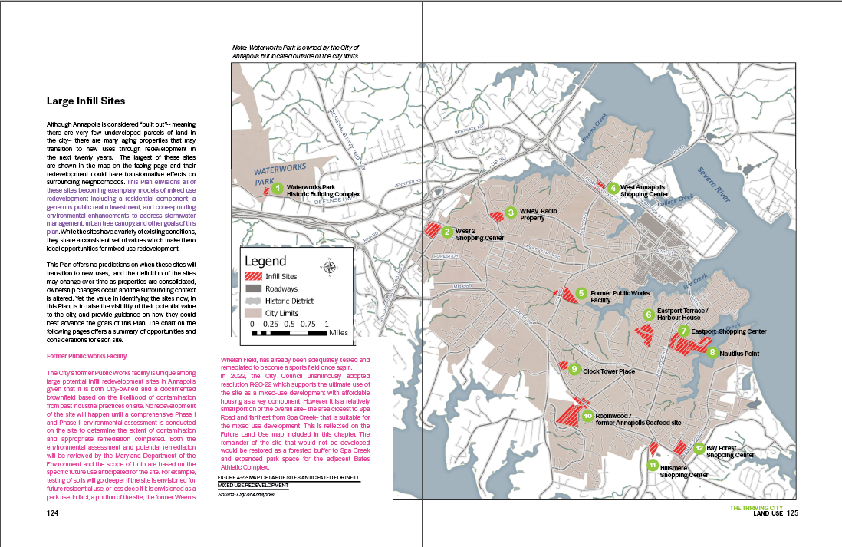
Notes:
FIGURE 4-22: MAP OF LARGE SITES ANTICIPATED FOR INFILL MIXED USE REDEVELOPMENT
Source: City of Annapolis

Slide 18
Notes:
FIGURE 5-12: THIS ILLUSTRATION SHOWS THE RANGE OF HOUSING TYPES THAT ARE CONSIDERED ‘MISSING MIDDLE HOUSING’ , A VARIETY OF SMALL-SCALE HOUSING OPTIONS NO LONGER ALLOWED BY THE ZONING REGULATIONS IN MANY CITIES AND COUNTIES ACROSS THE U.S. INCLUDING ANNAPOLIS.
Source: Opticos Design

Slide 19
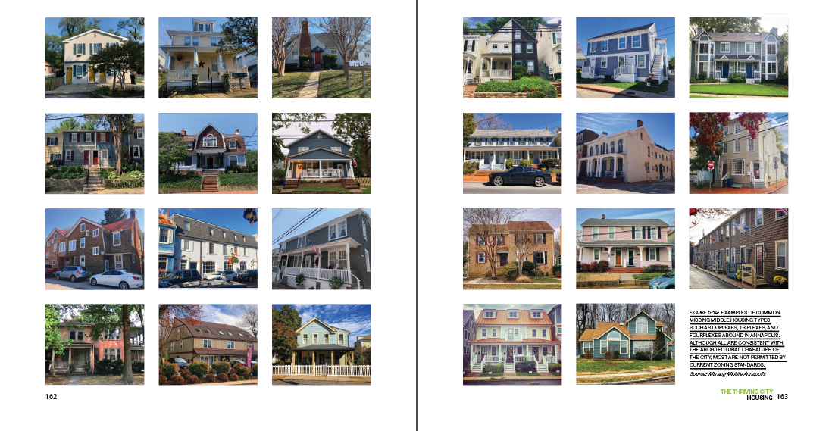
MISSING MIDDLE PRECEDENTS IN ANNAPOLIS TODAY

Slide 20
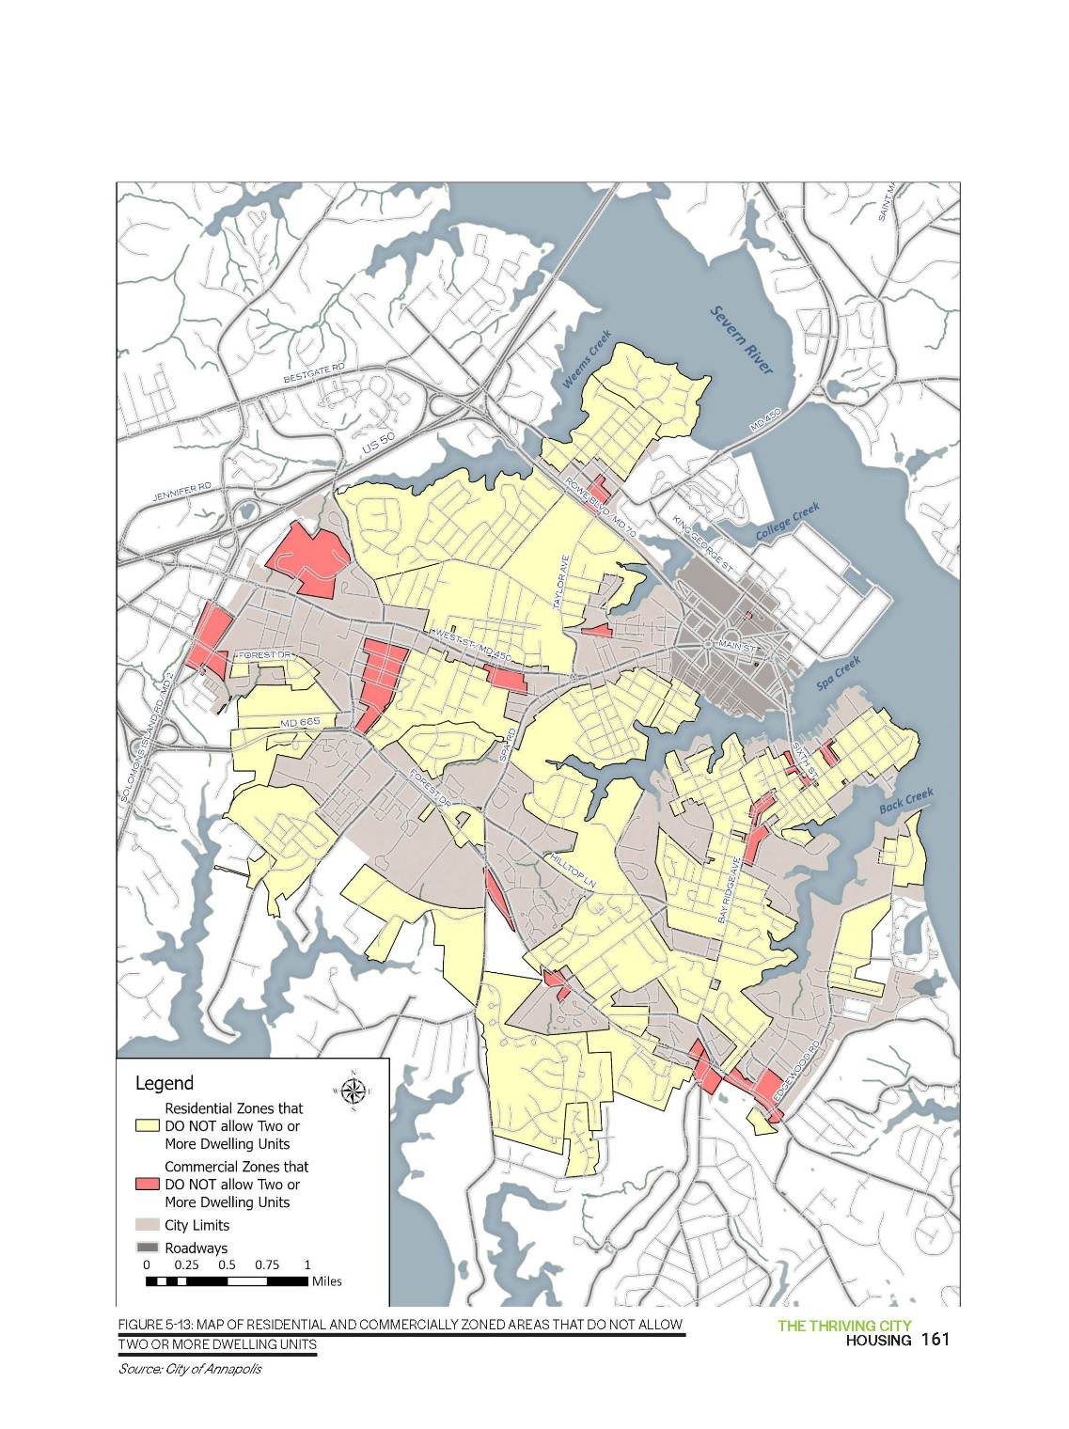
RESTRICTED ZONING AREAS
Notes:
FIGURE 5-13: MAP OF RESIDENTIAL AND COMMERCIALLY ZONED AREAS THAT DO NOT ALLOW TWO OR MORE DWELLING UNITS

Slide 21
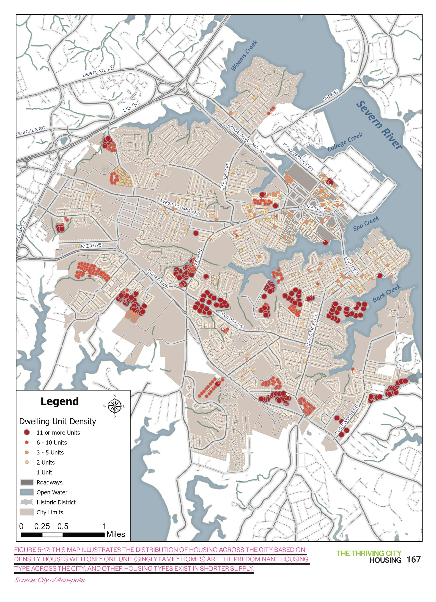
EXISTING HOUSING DENSITY
Notes:
FIGURE 5-13: MAP OF RESIDENTIAL AND COMMERCIALLY ZONED AREAS THAT DO NOT ALLOW TWO OR MORE DWELLING UNITS

Slide 22
Notes:
FIGURE 4-26: PROPOSED FORM-BASED ZONING DISTRICTS FOR WEST ANNAPOLIS FROM THE WEST
ANNAPOLIS MASTER PLAN (2021)

Slide 24
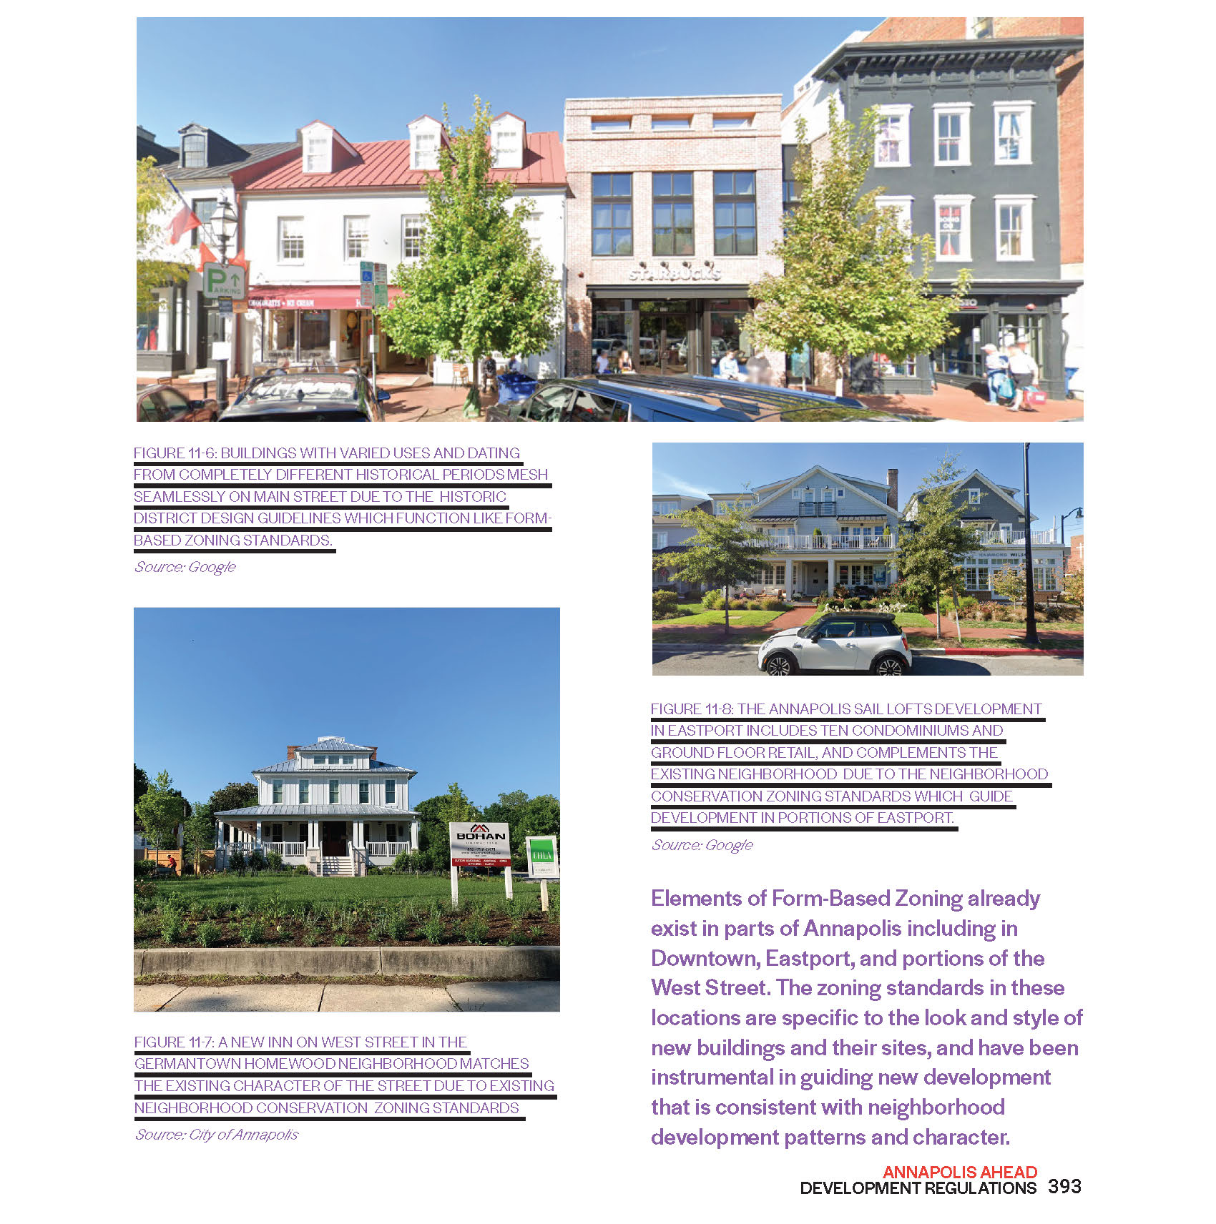

Slide 25
Ward 8 Plan and 12 Redevelopment Areas
Ward 8 Plan (handout 10)
12 Redevelopment Plans Slides and Handouts)
Two in Ward 8 – Eastport Shopping Center and Nautilus Point
Redevelopment in other areas will impact Ward 8, especially areas #9 thru #12

Slide 26
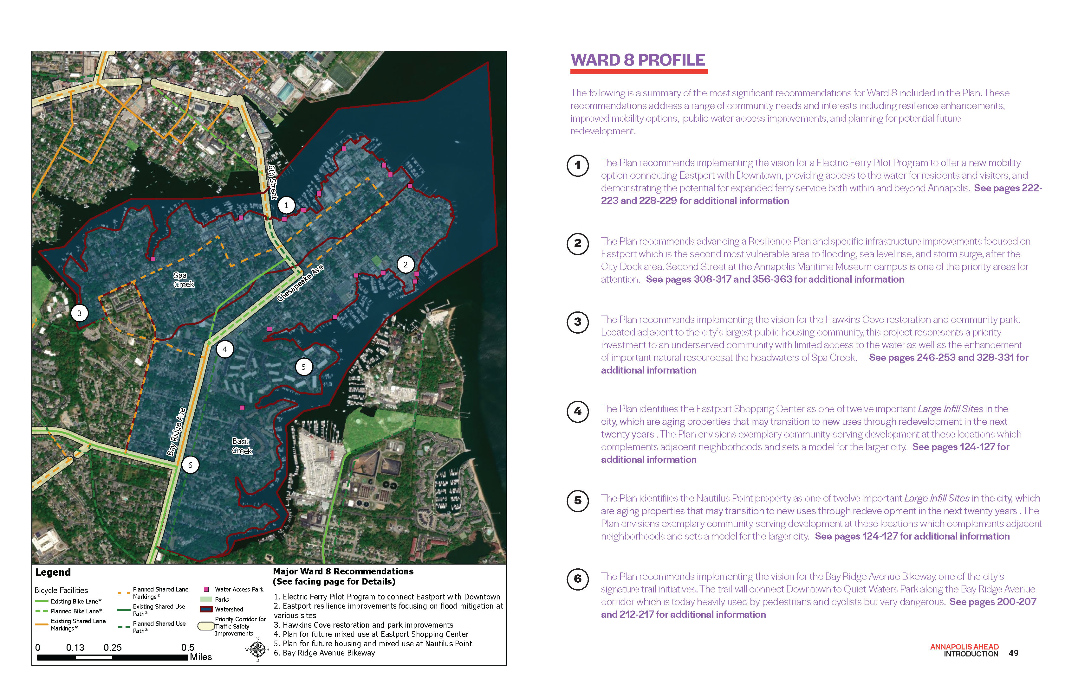

Slide 27
Adequate Public Facilities (APF) Plans
Capital investment plans must keep pace with development plans
APF covers Public Safety (Police, Fire and Emergency Services), Transportation, and Public Works, especially:
Utilities
Stormwater
Shoreline Restoration
Environment

Slide 28
Adequate Public Facilities (cont.)
Draft Comp Plan refers to the need for increased or improved infrastructure, but even in the Plan implantation steps it is light on specifics (see page 83 of the Action Steps)
There are City Council plans to revise the APF Code. This is a necessary step after adoption of the Draft Comp Plan in order to address the density called for in the Comp Plan

Slide 29
Next Steps Toward Adoption of Plan
Timeline for Council Passage of Regulation
11 July 2024
Unless City Council sends it back to the Planning Commission for substantive changes
Remaining Public Input Opportunities
Send email to your alderman
City Council
Planning Commission and/or Planning Staff

Slide 30
After Plan Adoption Actions
The Adopted Comp Plan is advisory, but
Planned Zoning Changes
Form-based Zoning
Changing Zoning Districts
Reducing Number of Districts
Changing all Commercial Districts to Mixed Use
Zoning Map Changes
Ward and Redevelopment Plans are next
ECA Board will need to monitor this

Slide 31
Comments and Questions?

